Slide 1
“ AI Chat Bot”
Presented by Spoorthy UK 1BI22SCS06 M. Tech, 2nd Sem Under the guidance of Dr.M.S. Bharghavi.
Associate Professor Dept. of CS&E

Slide 2
Abstract
In today's digital age, the advent of chatbots has transformed the way we interact with technology and services.
Chatbots, driven by artificial intelligence and natural language processing, have found applications in customer support, e-commerce, healthcare, education, and various other domains.
This project delves into the fascinating world of chatbot development using the Python programming language, aiming to explore two distinct approaches to building interactive chatbots.
The project begins by introducing the concept of chatbots, their significance in modern communication, and their real-world applications.

Slide 3
1. Introduction
In the ever-evolving landscape of technology, one innovation stands out for its transformative impact on human-computer interactions: chatbots.
These intelligent virtual agents, powered by artificial intelligence and natural language processing, have revolutionized the way we engage with technology and services.
In this era of instant communication and automation, chatbots have emerged as essential tools for businesses, organizations, and individuals alike.
They serve as versatile conversational interfaces, capable of answering questions, providing information, assisting with tasks, and even offering entertainment.

Slide 4
Problem Statement
The problem addressed by this project is the development and implementation of functional chatbot systems. These systems, designed to engage in human-like conversations, have become increasingly important in various domains, including customer service, information delivery, and entertainment.

Slide 5
Objectives
Understanding AI Chatbots
Python for Chatbot Development
Natural Language Processing (NLP)
Rule-Based Chatbots
Integration with APIs and Data Sources
Personalization and User Experience
Advanced AI Capabilities
Real-World Applications

Slide 6
Local Data Storage: Instead of storing sensitive data, such as trainees' email addresses and names, on public servers, the proposed system employs a local data storage approach.
Realistic Training Environment: The proposed system provides a realistic training environment by simulating phishing scenarios that closely resemble actual attacks.
User-friendly Interface: The system offers a user-friendly interface for trainers to manage campaigns, create phishing emails, and track trainees' behaviors.
Privacy and Compliance: The system addresses privacy concerns by pseudonymizing trainees' data and complying with data protection regulations.
Cost-effectiveness: By avoiding costly outsourced solutions and utilizing cloud services for hosting the phishing site, the proposed system minimizes the financial burden on organizations.

Slide 7
Problem Statement
In a rapidly evolving technological landscape, users seek efficient and natural ways to interact with their devices and computers. Traditional user interfaces, such as keyboards and touchscreens, while effective, may not always provide the most intuitive and convenient means of interaction. There is a need for a voice-controlled virtual assistant that can enhance the user experience by enabling hands-free and voice-activated communication with technology.

Slide 8
Dataset description:
In this project we have not used any particular datasets, here we have used some sentences and some questions and responses to train the chatbot.
Here the ChatterBot-based chatbot is being trained using the built-in ChatterBot English corpus, and no external dataset is explicitly mentioned or used for training.
The ChatterBot library comes with a pre-built corpus of conversational data that can be used to train the chatbot. This corpus includes a variety of text conversations covering different topics and contexts.

Slide 9
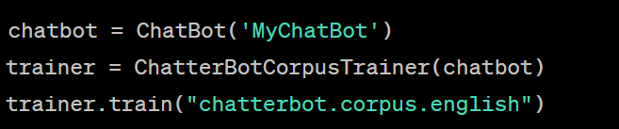
The code snippet that pertains to the training of the ChatterBot-based chatbot is as follows:
Fig 1: Snapshot-1

Slide 10
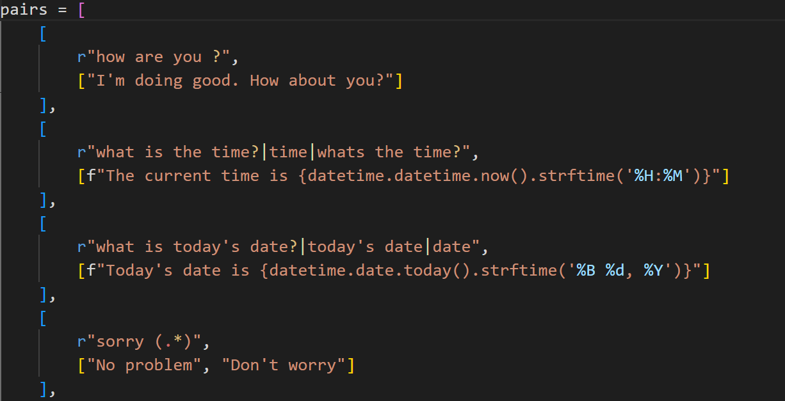
In the given context , the list of pairs we've defined can be considered as a form of dataset. This list of pairs contains predefined user inputs (patterns) along with corresponding chatbot responses. Each pair in the list serves as a training example for the rule-based chatbot created using NLTK's chat module.
Fig 2: Snapshot-2

Slide 11
Techniques used in the project:
1. Rule-Based Technique:
The rule-based technique involves constructing a chatbot using NLTK's chat module. This technique relies on predefined patterns and responses to handle user interactions.
Regular expressions are used to match user inputs to specific patterns, and when a match is found, the chatbot generates a response from the associated list of responses.
This approach is straightforward to implement and is suitable for scenarios where interactions follow specific patterns.

Slide 12
2. Machine Learning-Based Technique:
The machine learning-based technique is implemented using the ChatterBot library.
This approach involves training the chatbot using a dataset (in this case, the built-in ChatterBot English corpus) to learn from examples and generate responses.
The ChatterBot library employs natural language processing and machine learning algorithms to understand patterns in user inputs and generate contextually relevant responses.
This technique enables the chatbot to learn from a diverse range of conversations and generate responses that align with user queries.

Slide 13
Tools used:
1. NLTK (Natural Language Toolkit):
NLTK is a powerful Python library for natural language processing and text analysis.
2.ChatterBot Library:
ChatterBot is a Python library specifically designed for building chatbots using machine learning techniques.
3.Datetime Module:
The built-in `datetime` module in Python is used to work with date and time-related functions.

Slide 14
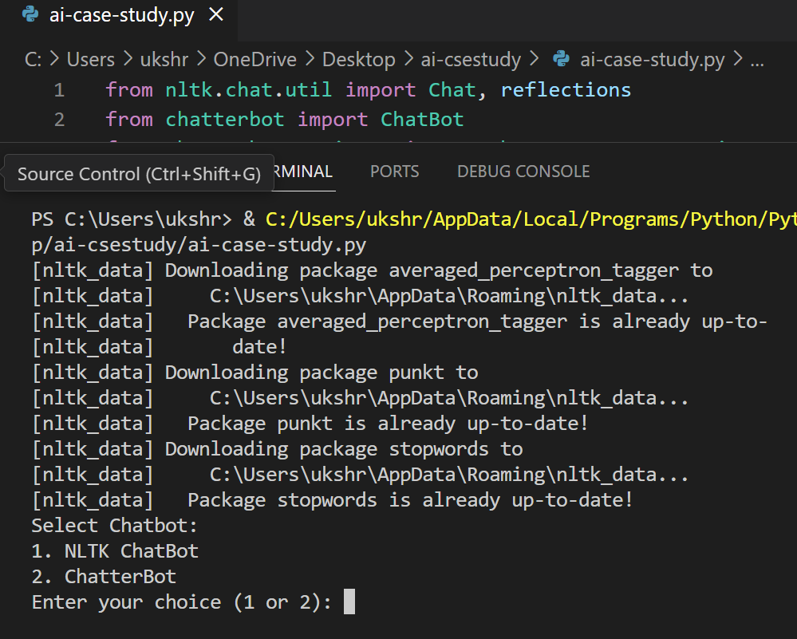
Results:

Slide 15
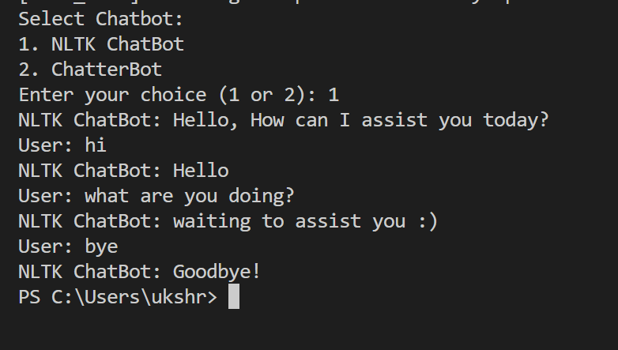

Slide 16
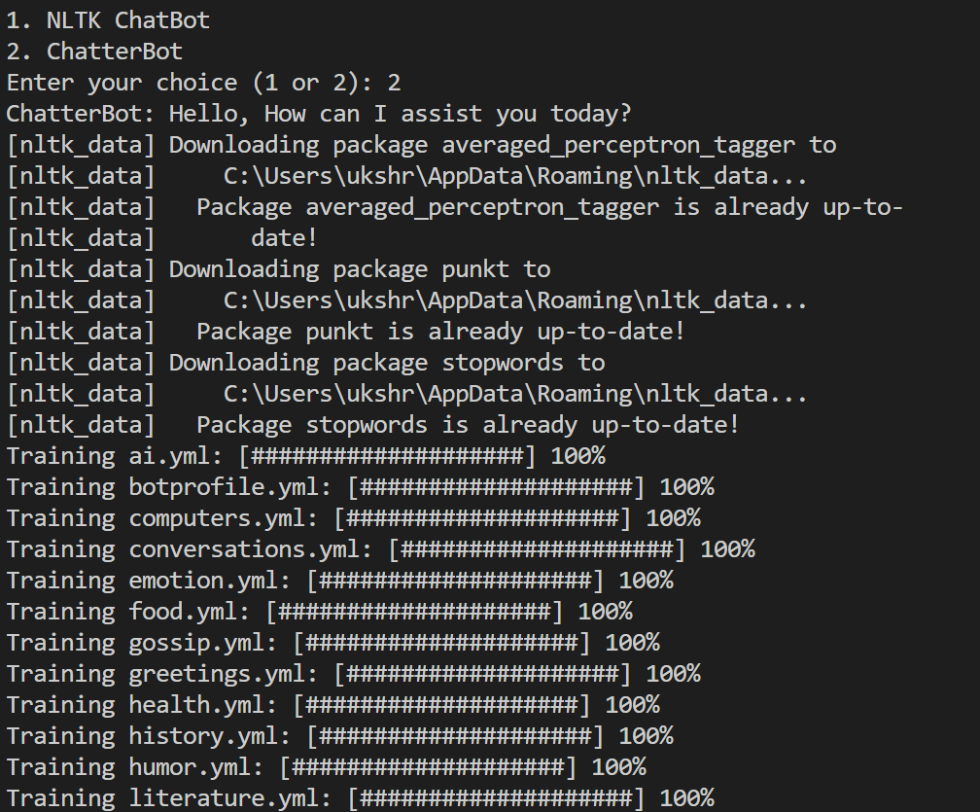

Slide 17
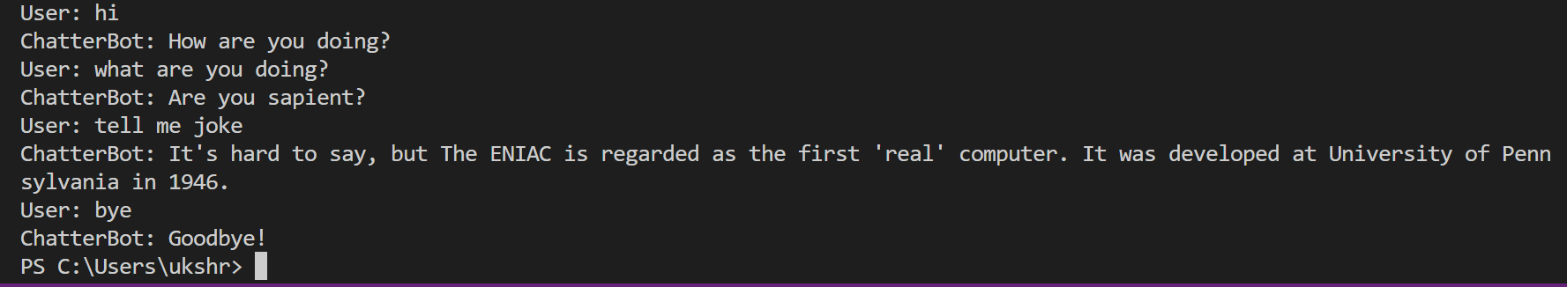

Slide 18
Conclusion:
In the ever-evolving landscape of technology, one innovation stands out for its transformative impact on human-computer interactions: chatbots.
These intelligent virtual agents, powered by artificial intelligence and natural language processing, have revolutionized the way we engage with technology and services.
In this era of instant communication and automation, chatbots have emerged as essential tools for businesses, organizations, and individuals alike.
They serve as versatile conversational interfaces, capable of answering questions, providing information, assisting with tasks, and even offering entertainment.

Slide 19
Thank You

